Slide 1
Implementation levels of virtualization
Module ii

Slide 2
Levels of virtualizations
Instruction Set Architecture Level
Hardware Abstraction Level
Operating System Level
Library Support Level
User-Application Level

Slide 3
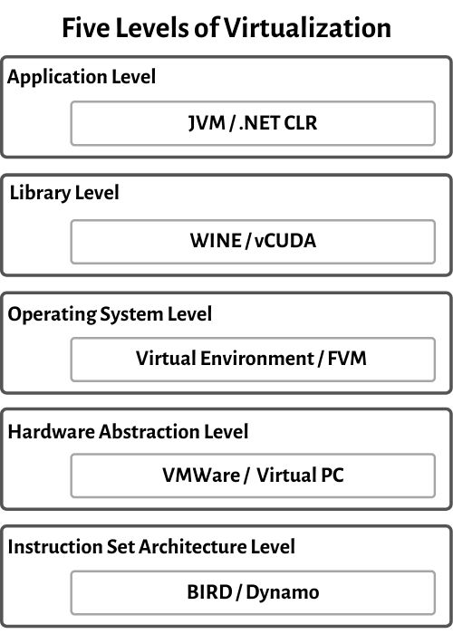

Slide 4
Instruction Set Architecture Level
Instruction Set Architecture Level (ISA) ISA virtualization can work through ISA emulation. This is used to run many legacy codes that were written for a different configuration of hardware. These codes run on any virtual machine using the ISA.
The basic emulation method is through code interpretation. An interpreter program interprets the source instructions to target instructions one by one.
For better performance, dynamic binary translation is desired. This approach translates basic blocks of dynamic source instructions to target instructions. The basic blocks can also be extended to program traces or super blocks to increase translation efficiency. Instruction set emulation requires binary translation and optimization. A virtual instruction set architecture (V-ISA) thus requires adding a processor-specific software translation layer to the compiler.

Slide 5
Hardware Abstraction Level (HAL)
Hardware-level virtualization is performed right on top of the bare hardware.
this approach generates a virtual hardware environment for a VM.
the process manages the underlying hardware through virtualization.
The idea is to virtualize a computer’s resources, such as its processors, memory, and I/O devices.
The intention is to upgrade the hardware utilization rate by multiple users concurrently. the Xen hypervisor has been applied to virtualize x86-based machines to run Linux or other guest OS applications.

Slide 6
Operating System Level
OS-level virtualiza-tion creates isolated containers on a single physical server and the OS instances to utilize the hard-ware and software in data centers.
The containers behave like real servers. OS-level virtualization is commonly used in creating virtual hosting environments to allocate hardware resources among a large number of mutually distrusting users.
It is also used, to a lesser extent, in consolidating server hardware by moving services on separate hosts into containers or VMs on one server.

Slide 7
Library Support Level
Most applications use APIs exported by user-level libraries rather than using lengthy system calls by the OS.
Since most systems provide well-documented APIs, such an interface becomes another candidate for virtualization.
Virtualization with library interfaces is possible by controlling the communication link between applications and the rest of a system through API hooks.
The software tool WINE has implemented this approach to support Windows applications on top of UNIX hosts. Another example is the vCUDA which allows applications executing within VMs to leverage GPU hardware acceleration.

Slide 8
User-Application Level
Virtualization at the application level virtualizes an application as a VM. On a traditional OS, an application often runs as a process. Therefore, application-level virtualization is also known as process-level virtualization. The most popular approach is to deploy high level language (HLL) VMs.
The process involves wrapping the application in a layer that is isolated from the host OS and other applications.
the virtualization layer sits as an application program on top of the operating system, and the layer exports an abstraction of a VM that can run programs written and compiled to a particular abstract machine definition. Any program written in the HLL and compiled for this VM will be able to run on it. The Microsoft .NET CLR and Java Virtual Machine (JVM)

Slide 9
Virtualization Structures - Tools and Mechanisms
Module ii

Slide 10
Before virtualization, the operating system manages the hardware. After virtualization, a virtualization layer is inserted between the hardware and the operating system.
In such a case, the virtualization layer is responsible for converting portions of the real hardware into virtual hardware.
Therefore, different operating systems such as Linux and Windows can run on the same physical machine, simultaneously.
Depending on the position of the virtualization layer, there are several classes of VM architectures, namely the hypervisor architecture, para-virtualization, and host-based virtualization. The hypervisor is also known as the VMM (Virtual Machine Monitor). They both perform the same virtualization operations.

Slide 11
Hypervisor and Xen Architecture
The hypervisor supports hardware-level virtualization on bare metal devices like CPU, memory, disk and network interfaces. The hypervisor software sits directly between the physi-cal hardware and its OS. This virtualization layer is referred to as either the VMM or the hypervisor. The hypervisor provides hypercalls for the guest OSes and applications.
A micro-kernel hypervisor
A monolithic hypervisor

Slide 12
A micro-kernel hypervisor includes only the basic and unchanging functions (such as physical memory management and processor scheduling). The device drivers and other changeable components are outside the hypervisor.
A monolithic hypervisor implements all the functions, including those of the device drivers. Therefore, the size of the hypervisor code of a micro-kernel hyper-visor is smaller than that of a monolithic hypervisor. Essentially, a hypervisor must be able to convert physical devices into virtual resources dedicated for the deployed VM to use.

Slide 13
The Xen Architecture
Xen is an open source hypervisor program.
Xen is a micro-kernel hypervisor, which separates the policy from the mechanism. The Xen hypervisor implements all the mechanisms, leaving the policy to be handled by Domain 0.
Xen provides a virtual environment located between the hardware and the OS.
The core components of a Xen system are the hypervisor, kernel, and applications.

Slide 14
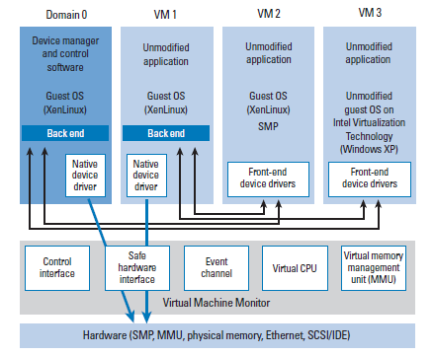
Xen architecture

Slide 15
Xen 3.0 is designed to enable para-virtualization of all three hardware components.
CPU operations.
Memory operations
I/O operations

Slide 16
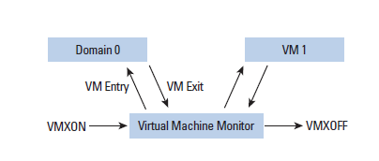
VMM support in intel

Slide 17
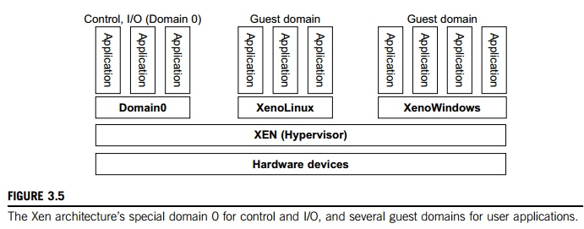

Slide 18
Like other virtualization systems, many guest OSes can run on top of the hypervisor. However, not all guest OSes are created equal, and one in particular controls the others.
The guest OS, which has control ability, is called Domain 0, and the others are called Domain U. Domain 0 is a privileged guest OS of Xen.
It is first loaded when Xen boots without any file system drivers being available.
Domain 0 is designed to access hardware directly and manage devices.
Therefore, one of the responsibilities of Domain 0 is to allocate and map hardware resources for the guest domains.

Slide 19
Binary Translation with Full Virtualization
hardware virtualization can be classified into two categories: full virtualization and host-based virtualization.
Full virtualization does not need to modify the host OS. It relies on binary translation to trap and to virtualize the execution of certain sensitive, nonvirtualizable instructions.
The guest OSes and their applications consist of noncritical and critical instructions.
With full virtualization, noncritical instructions run on the hardware directly while critical instructions are discovered and replaced with traps into the VMM to be emulated by software. Both the hypervisor and VMM approaches are considered full virtualization

Slide 20
Binary translation is a software virtualization and includes the use of an interpreter. It translates binary code to another binary, but excluding nontrapping instructions.

Slide 21
Binary translation
Ring 3
Application
Direct
Execution
of user and OS
Requests
Ring 2
Ring 1
Guest OS
Ring 0
VMM
Binary translation
of OS Requests
Hardware
VMM: Virtual Machine Monitor

Slide 22
OS assisted (Paravirtualization)
Paravirtualization – via an modified OS kernel as guest OS
It is very difficult to build the more sophisticated binary translation support necessary for full virtualization.
Paravirtualization involves modifying the OS kernel to replace non-virtualizable instructions with hypercalls that communicate directly with the virtualization layer hypervisor.
The hypervisor also provides hypercall interfaces for other critical kernel operations such as memory management, interrupt handling and time keeping.
Paravirtualization is different from full virtualization, where the unmodified OS does not know it is virtualized and sensitive OS calls are trapped using binary translation.
Paravirtualization cannot support unmodified OS
Example:
Xen -- modified Linux kernel and a version of Windows XP

Slide 23
OS assisted (Paravirtualization)
Ring 3
Application
Direct
Execution
of user and OS
Requests
Ring 2
Ring 1
Ring 0
Paravirtualized
Guest OS
Virtualization layer
Hypercalls to the
Virtualization Layer
replace
non-virtualiable
OS instructions
Hardware
VMM: Virtual Machine Monitor

Slide 24
Hardware Assisted Virtualization
Ring 3
Application
Direct
Execution
of user and OS
Requests
Ring 2
Non-root
Mode
Privilege
Levels
Ring 1
Ring 0
Guest OS
VMM
OS requests traps
to VMM without
binary translation
or paravirtualization
Root Mode
Privilege
Levels
Hardware
VMM: Virtual Machine Monitor

Slide 25
KVM (Kernel-Based VM)
This is a Linux para-virtualization system—a part of the Linux version 2.6.20 kernel.
Memory management and scheduling activities are carried out by the existing Linux kernel.
The KVM does the rest, which makes it simpler than the hypervisor that controls the entire machine.
KVM is a hardware-assisted para-virtualization tool, which improves performance and supports unmodified guest OSes such as Windows, Linux, Solaris, and other UNIX variants.

Slide 26
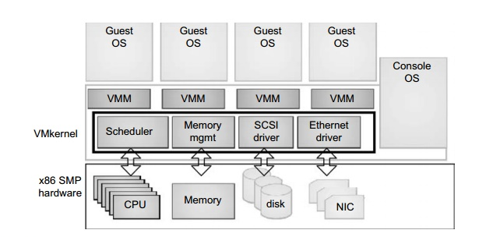
Para-Virtualization with Compiler Support

Slide 27
Unlike the full virtualization architecture which intercepts and emulates privileged and sensitive instructions at runtime, para-virtualization handles these instructions at compile time. The guest OS kernel is modified to replace the privileged and sensitive instructions with hypercalls to the hypervi-sor or VMM. Xen assumes such a para-virtualization architecture.
The VMM layer virtualizes the physical hardware resources such as CPU, memory, network and disk controllers, and human interface devices. Every VM has its own set of virtual hardware resources. The resource manager allocates CPU, memory disk, and network bandwidth and maps them to the virtual hardware resource set of each VM created. Hardware interface components are the device drivers and the

Slide 28
VMware ESX Server File System. The service console is responsible for booting the system, initiating the execution of the VMM and resource manager, and relinquishing control to those layers. It also facilitates the process for system administrators.

